Slide 1
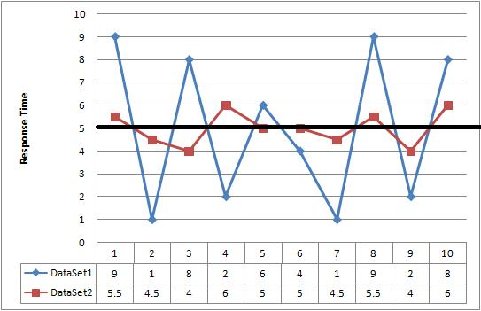
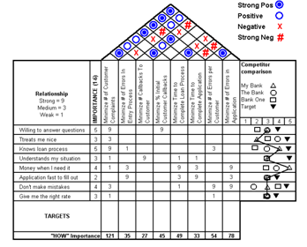
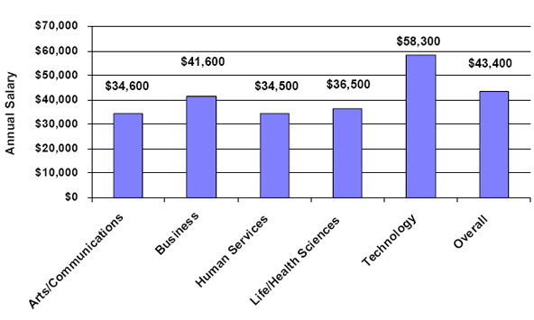
Without data,
Frequency
9.80
9.90
10.0
10.1
10.2
10.3
10.4
10.5
You’re just another person
with an opinion.

